Slide 1



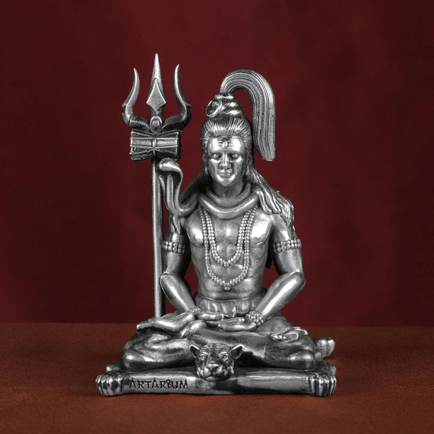
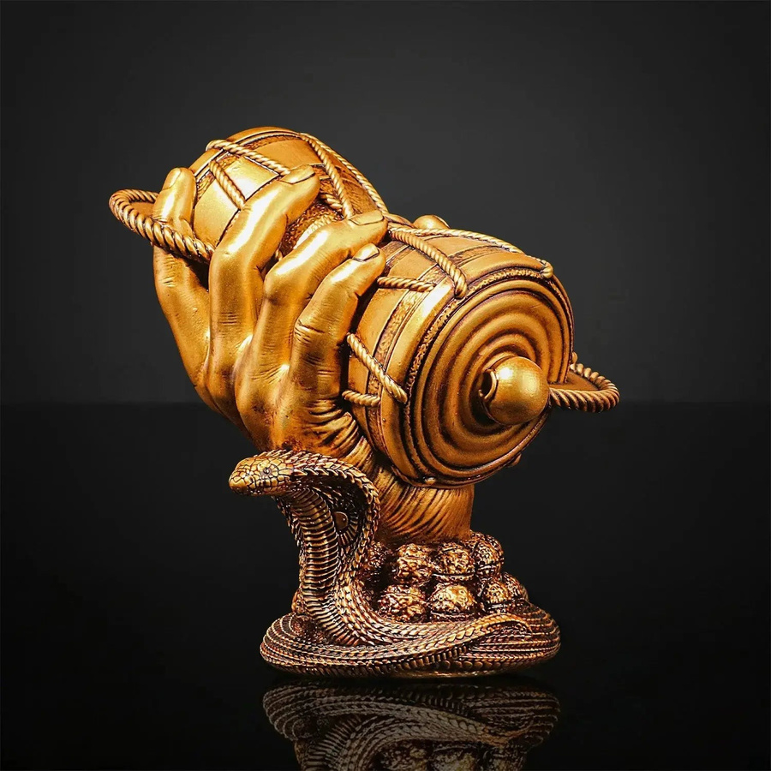

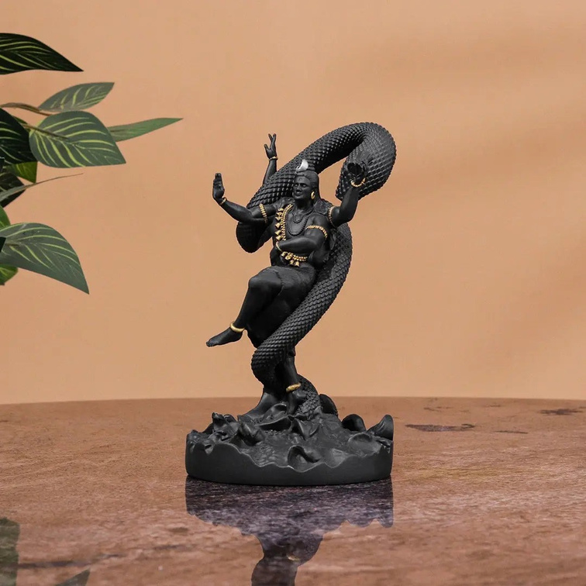

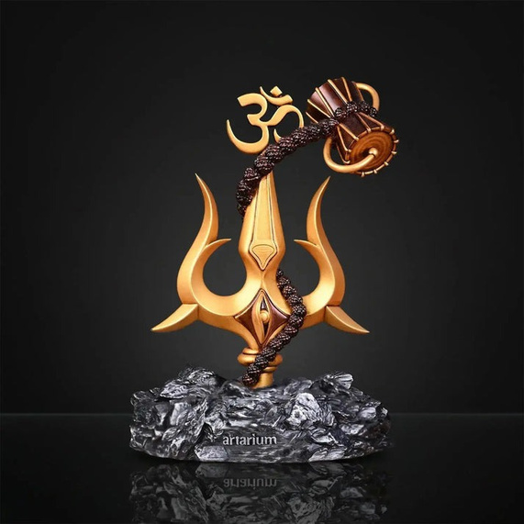
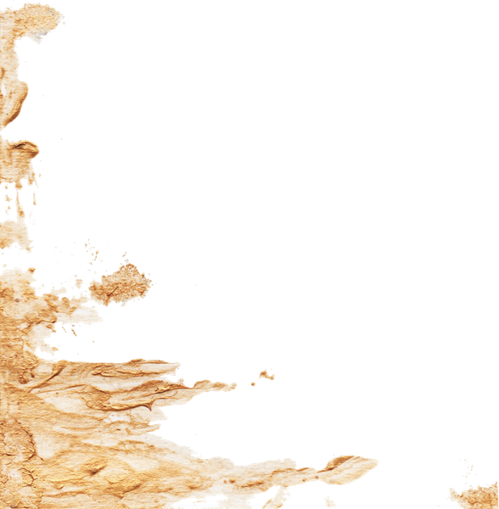
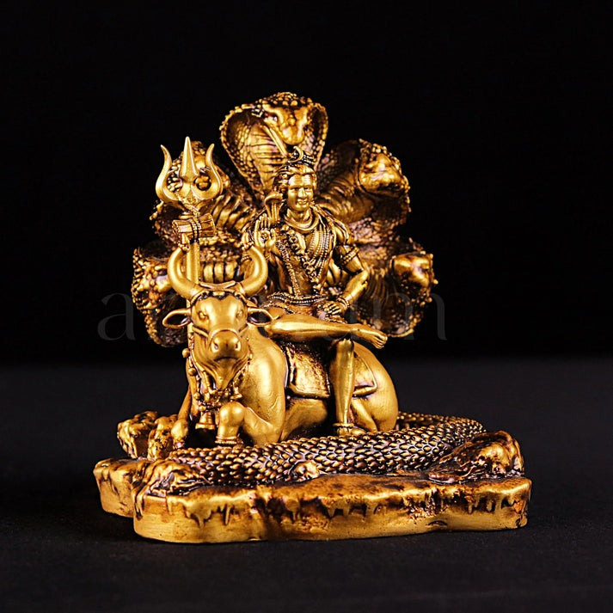
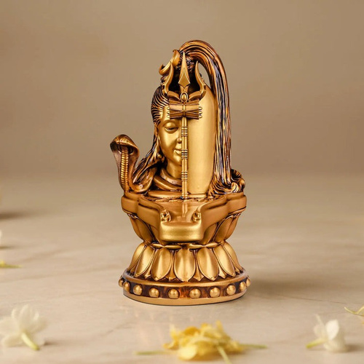
LORD SHIVA IDOLS ELEVATE YOUR SPIRITUAL SPACE BY EMBODYING THE COSMIC POWER OF MAHADEV.
Shiva Statues
https://artarium.com/collections/god-shiva-statue

Slide 2

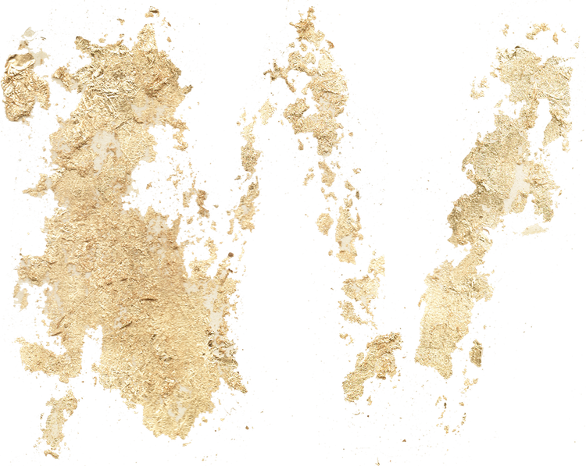
About
Shiva statues
Bring divine energy into your surroundings with beautifully designed Shiva statues from Artarium. From serene Adiyogi sculptures to mystical dancing Shiva forms, each statue is crafted with attention to detail and spiritual significance. These Shiva statues are ideal for home temples, offices, or meditation corners, helping create a peaceful atmosphere filled with positivity and sacred vibrations.

Slide 3



Lord Shiva idols

Slide 4
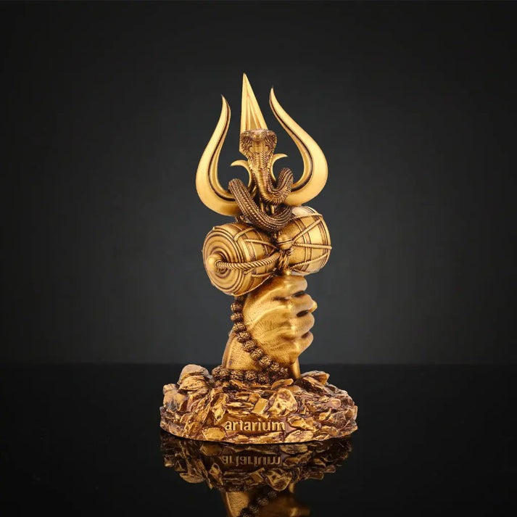
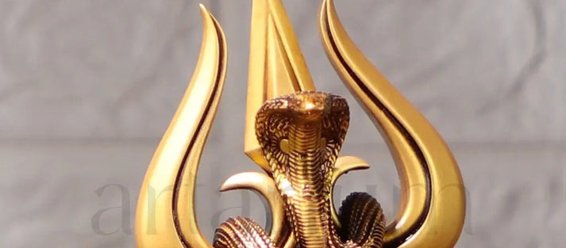
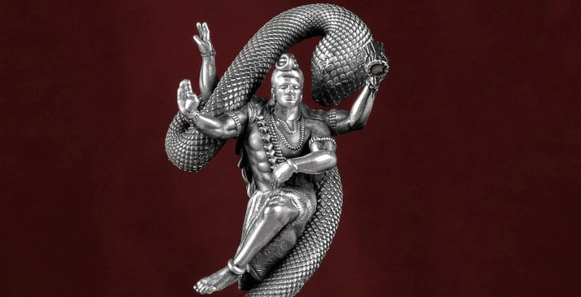
ARTARIUM OFFERS A STUNNING COLLECTION OF SHIVA STATUES INSPIRED BY THE POWERFUL FORMS OF LORD SHIVA.

Slide 5



Contact Us
For more assets and information, scan here

